Slide 1
AIT MIL-STD 1553 VeriStand 2013 Add-On
Viewpoint Systems| Q4 2014
Notes:
Include the Product Name
Company Name
Current Date

Slide 2
Audience—NI Sales
Information: This one-slider is meant to be a “grab-and-go” asset for you to reference high-level, must-know information about AIT MIL-STD 1553 VeriStand 2013 Add-On
Use-Case: Please integrate this slide into presentations where articulating high-level information about AIT MIL-STD 1553 VeriStand 2013 Add-On is appropriate.
Last Updated: 10/16/2014

Slide 3
Audience—NI Sales
Information: This one-slider is meant to be a “grab-and-go” asset for you to reference high-level, must-know information about DIAdem 2012.
Use-Case: Please integrate this slide into presentations where articulating high-level information about DIAdem 2012 is appropriate.
Last Updated: 6/22/2012
EXAMPLE
Notes:
NI Internal Example

Slide 4
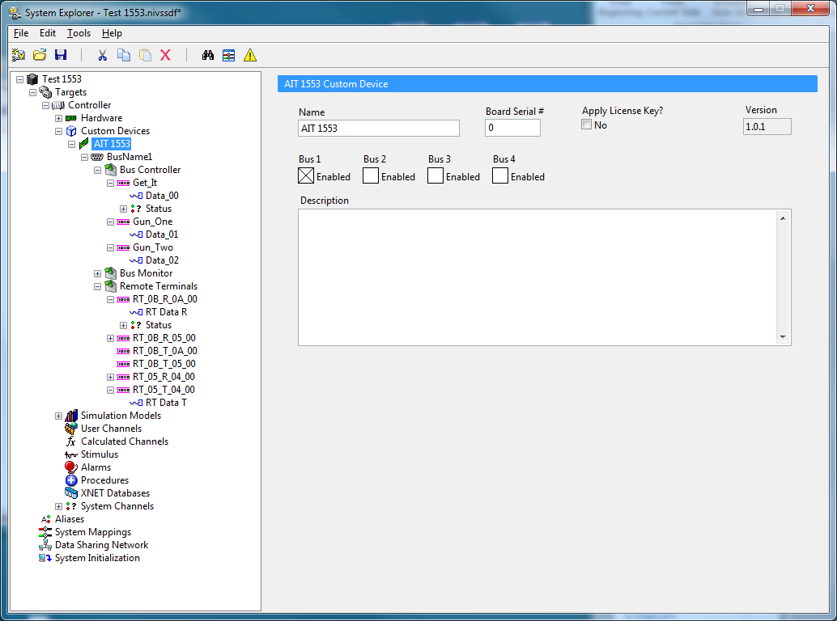
AIT MIL-STD 1553 VeriStand 2013 Add-On
Use AIT MIL-STD 1553 HW in Veristand
Configured via AIT’s Flight Simulyzer
30 Day Full Featured Trial
Import/Export VeriStand Parameters
Supports Bus Controller, Bus Monitor & Remote Terminals
Multi-Bus Support
Download at ni.com/labviewtools
Notes:
For information about DIAdem sales in Japan, contact Kwoya.

Slide 5
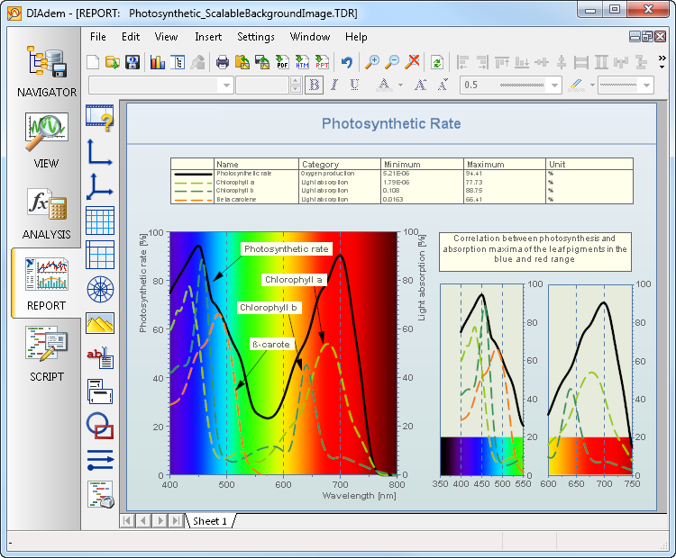
NI DIAdem 2012
Data to decision, faster
Unparalleled data management and mining
Flexible software environment
Object-Oriented VBScript API for reporting, significantly reducing programming time and effort
Added support for NI-XNET devices including LIN and FlexRay database formats
EXAMPLE
Learn more at ni.com/diadem
Notes:
For information about DIAdem sales in Japan, contact Kwoya.

